Slide 1
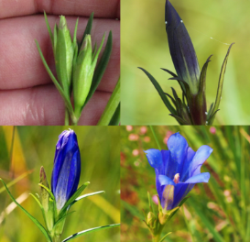
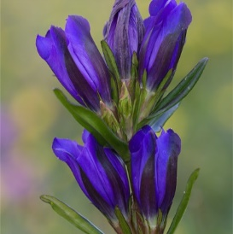
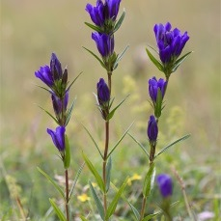
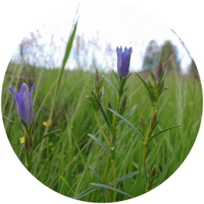
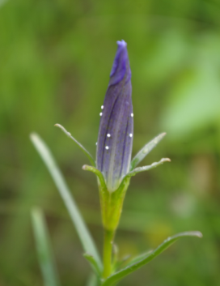
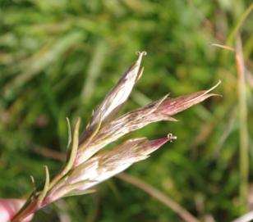
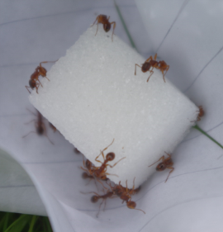
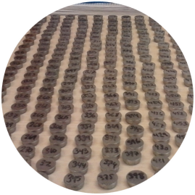
Not included: correlations among traits population effects, coefficients with p<0.1
Unstandardized coefficients
Standardized coefficients (linear models)
* p<0.05; · p<0.1
0.13·
0.05
Fl phen
0.11*
0.71*
Fl N
0.45*
0.29*
0.14*
0.48*
0.03*
-0.01
Shoot h
-0.03*
-0.12*
0.04*
0.12·
Veg h
0.03*
0.14*
-0.06*
-0.42*
0.03*
0.11*
N eggs
N intact fr
-0.60*
-0.19*
0.20*
0.05
N ants
Temp

Slide 2
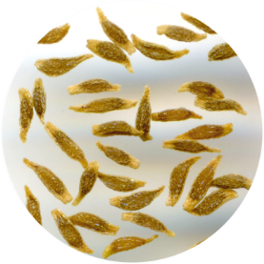
Not included: correlations among traits population effects, coefficients with p<0.1
Unstandardized coefficients
Standardized coefficients (linear models)
* p<0.05; · p<0.1
0.19*
0.03
0.13·
0.05
Fl phen
0.11*
0.71*
Fl N
0.03*
0.00
0.45*
0.29*
0.14*
0.48*
0.03*
-0.01
Shoot h
-0.03*
-0.12*
0.04*
0.12·
Veg h
0.03*
0.14*
-0.06*
-0.42*
0.36*
0.88*
0.03*
0.11*
N eggs
N intact fr
N dev seeds
-0.60*
-0.19*
0.20*
0.05
N ants
Temp

Slide 3
A) n = 303; Fisher′s C = 14.99; P = 0.242
Flowering phenology
Flower number
0.29
0.45
0.71
0.11
Shoot height
0.48
0.14
-0.01
0.03
Vegetation height
0.12
0.04
-0.12
-0.03
0.14
0.03
Number of eggs
R² = 0.32
Number of intact fruits
R² = 0.71
-0.42
-0.06
0.11
0.03
Myrmica abundance
R² = 0.16
-0.19
-0.60
Soil temperature
0.05
0.20

Slide 4
B) n = 245; Fisher′s C = 14.38; P = 0.570
Flowering phenology
0.03
0.19
Flower number
0.26
0.41
0.58
0.12
Shoot height
0.00
0.03
0.52
0.15
-0.03
0.03
Vegetation height
0.10
0.04
-0.09
-0.02
0.18
0.03
Number of eggs
R² = 0.27
Number of intact fruits
R² = 0.73
Number of seeds
R² = 0.85
-0.27
-0.06
0.88
0.34
Myrmica abundance
R² = 0.15
0.14
0.02
-0.20
-0.53
Soil temperature

Slide 5
Not included: correlations among traits, population effects
Standardized coefficients (linear models)
Unstandardized coefficients
Flowering phenology
0.05
0.13
Flower number
0.71
0.11
0.29
0.45
0.48
0.14
Shoot height
-0.01
0.03
0.12
0.04
Vegetation height
-0.12
-0.03
0.14
0.03
Number of eggs
Number of intact fruits
-0.42
-0.06
0.11
0.03
Myrmica abundance
-0.19
-0.60
Soil temperature
0.05
0.20

Slide 6
Flowering phenology
ns
0.19
Flower number
0.29
0.45
0.71
0.11
Shoot height
ns
0.03
0.48
0.14
ns
0.03
Vegetation height
Vegetation height
ns
0.04
-0.12
-0.03
0.18
0.03
Number of eggs
R² = 0.32
Number of intact fruits
R² = 0.71
Number of seeds
R² = 0.85
-0.42
-0.06
0.88
0.34
Myrmica abundance
R² = 0.15
0.14
0.02
-0.19
-0.60
Soil temperature
ns
0.20

Slide 7
Only standardized coefs + only significant paths shown (POSTER)
Flowering phenology
Shoot height
Flower number
0.09
0.29
0.12
0.48
0.71
Vegetation height
-0.12
0.18
Myrmica abundance
Number of eggs
Number of intact fruits
Number of seeds
0.14
-0.42
0.88
Soil temperature
-0.19

